Slide 1
Murach’s SQL Server 2022 for Developers
Chapter 1
An introduction
to relational databases and SQL

Slide 2
Objectives
Knowledge
Identify the three main hardware components of a client/server system.
Describe the way a client accesses the database on a server using these terms: application software, data access API, database management system, SQL query, and query results.
Describe the way a database is organized using these terms: tables, columns, rows, and cells.
Describe how the tables in a relational database are related using these terms: primary key and foreign key.
Identify the three types of relationships that can exist between two tables.
Describe the way the columns in a table are defined using these terms: data type, null value, default value, and identity column.

Slide 3
Objectives (cont.)
Describe the relationship between standard SQL and Microsoft SQL Server’s Transact-SQL.
Describe the difference between DML statements and DDL statements.
Describe the difference between an action query and a SELECT query.
List three coding techniques that can make your SQL code easier to read and maintain.

Slide 4
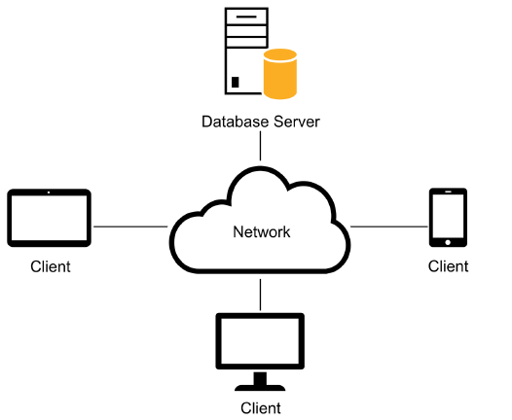
A simple client/server system

Slide 5
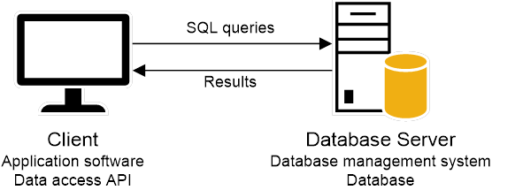
Client software, server software, and the SQL interface
How the SQL interface works
The application software communicates with the DBMS by sending SQL queries through the data access API.
When the DBMS receives a query that requests data, it processes the query and returns the query results to the client.

Slide 6
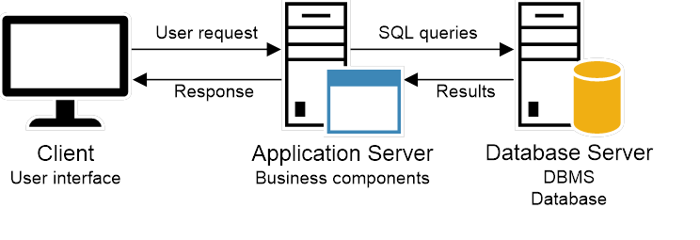
A Windows-based system that uses an application server
How application servers are used
An application server handles the processing for an application and uses SQL to communicate with the database server.

Slide 7
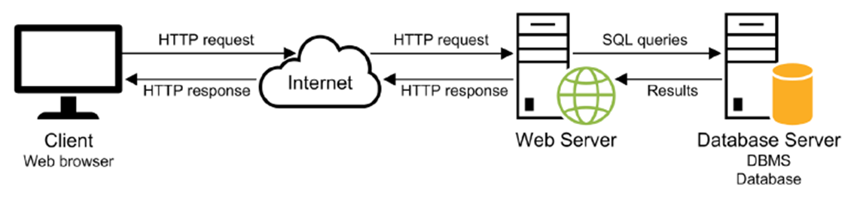
A simple web-based system
How web servers are used
A web server uses a protocol known as HTTP (Hypertext Transfer Protocol) to communicate with the client. It can also use SQL to communicate with the database server.
In a web-based system, it’s common for the client to use a web browser to communicate with a web server that’s running somewhere on the internet.

Slide 8
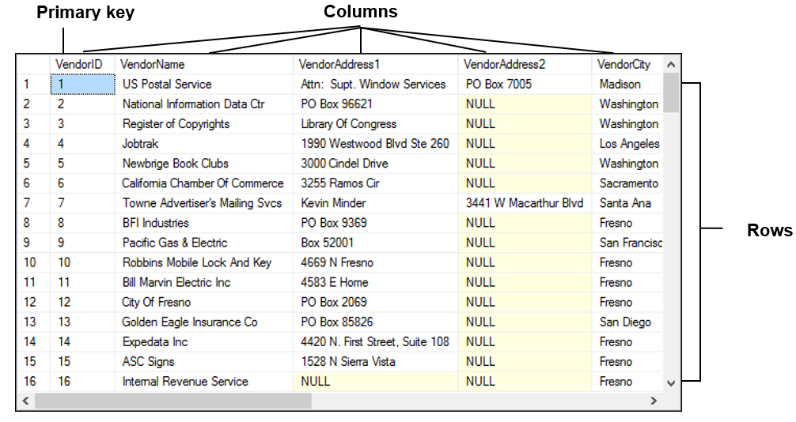
The Vendors table

Slide 9
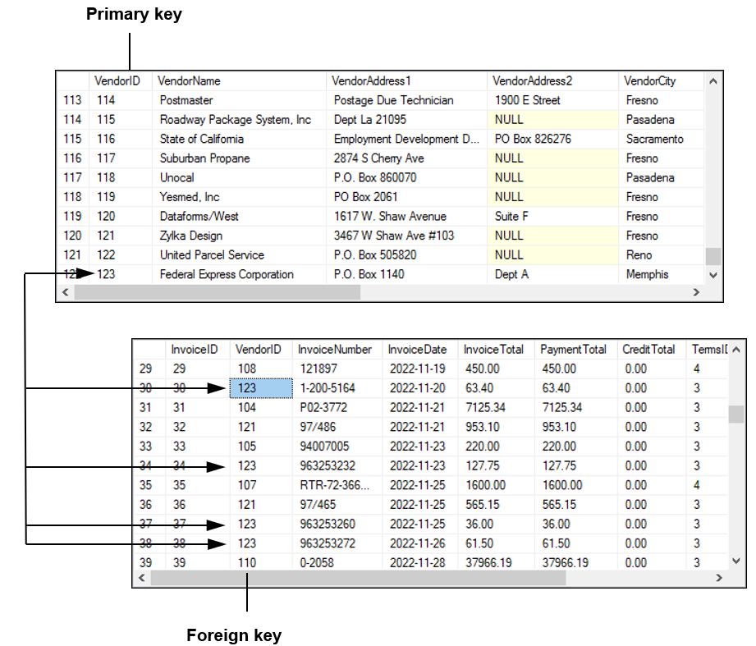
The relationship between two tables

Slide 10
Three types of database table relationships
One-to-many relationship
One-to-one relationship
Many-to-many relationship

Slide 11
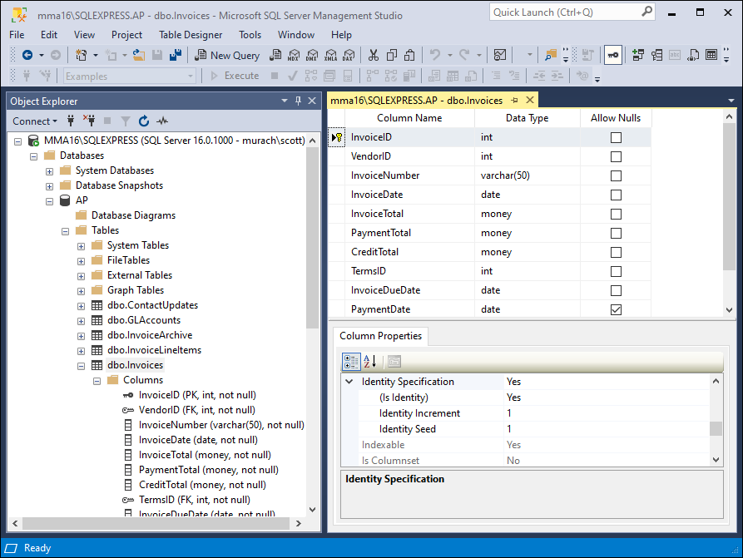
The columns of the Invoices table

Slide 12
Common SQL Server data types
bit
int, bigint, smallint, tinyint
money, smallmoney
decimal, numeric
float, real
date, time, datetime2
char, varchar
nchar, nvarchar

Slide 13
Standard SQL and dialects
Dialects in SQL
Although SQL is a standard language, each vendor has its own SQL dialect that may include extensions to the standards.
SQL Server’s dialect is called Transact-SQL or T-SQL for short.
How knowing “standard SQL” helps you
Most SQL statements are the same for all SQL dialects.
Once you have learned one SQL dialect, you can easily learn other dialects.
How knowing “standard SQL” does not help you
Any non-trivial application will require modification when moved from one relational database to another.

Slide 14
Relational databases
First releases
Oracle 1979
DB2 1985
MySQL 2000
SQL Server 1987
Primary platforms
Oracle Unix/Linux; z/OS
DB2 OS/390 and z/OS; Unix/Linux
MySQL Unix/Linux; Windows; macOS
SQL Server Windows; Linux

Slide 15
SQL DML statements
SELECT
INSERT
UPDATE
DELETE

Slide 16
SQL DDL statements
CREATE DATABASE
CREATE TABLE
CREATE INDEX
ALTER TABLE
ALTER INDEX
DROP DATABASE
DROP TABLE
DROP INDEX

Slide 17
A statement that creates a new database
CREATE DATABASE AP;

Slide 18
A statement that creates a new table
CREATE TABLE Invoices
(
InvoiceID INT NOT NULL IDENTITY
PRIMARY KEY,
VendorID INT NOT NULL REFERENCES
Vendors(VendorID),
InvoiceNumber VARCHAR(50) NOT NULL,
InvoiceDate SMALLDATETIME NOT NULL,
InvoiceTotal MONEY NOT NULL,
PaymentTotal MONEY NOT NULL DEFAULT 0,
CreditTotal MONEY NOT NULL DEFAULT 0,
TermsID INT NOT NULL REFERENCES
Terms(TermsID),
InvoiceDueDate SMALLDATETIME NOT NULL,
PaymentDate SMALLDATETIME NULL
);

Slide 19
Statements that work with the table
Add a new column to the table
ALTER TABLE Invoices
ADD BalanceDue MONEY NOT NULL;
Delete the new column
ALTER TABLE Invoices
DROP COLUMN BalanceDue;
Create an index on the table
CREATE INDEX IX_Invoices_VendorID
ON Invoices (VendorID);

Slide 20
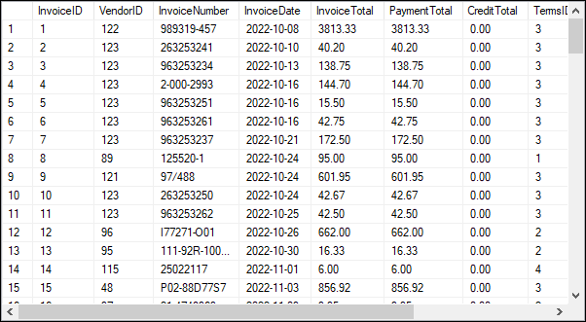
The Invoices base table

Slide 21
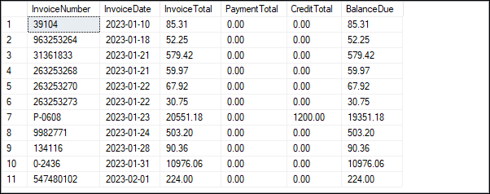
A statement that retrieves and sorts selected columns and rows
SELECT InvoiceNumber, InvoiceDate, InvoiceTotal,
PaymentTotal, CreditTotal,
InvoiceTotal - PaymentTotal – CreditTotal
AS BalanceDue
FROM Invoices
WHERE InvoiceTotal - PaymentTotal - CreditTotal > 0
ORDER BY InvoiceDate;
The result set defined by the statement

Slide 22
A statement that joins data from two tables
SELECT VendorName, InvoiceNumber, InvoiceDate,
InvoiceTotal
FROM Vendors INNER JOIN Invoices
ON Vendors.VendorID = Invoices.VendorID
WHERE InvoiceTotal >= 500
ORDER BY VendorName, InvoiceTotal DESC;

Slide 23
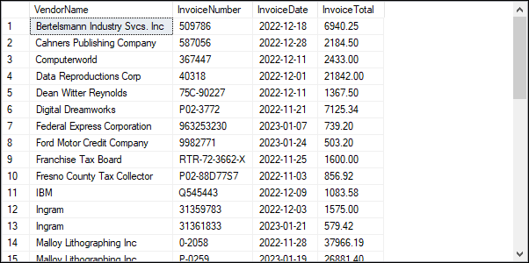
The result set defined by the join

Slide 24
A statement that adds a row to the Invoices table
INSERT INTO Invoices (VendorID, InvoiceNumber,
InvoiceDate, InvoiceTotal, TermsID, InvoiceDueDate)
VALUES (12, '3289175’, '4/18/2022', 165, 3, '5/18/2022');

Slide 25
Two statements that update the data in the Invoices table
Change the value for a single row
UPDATE Invoices
SET CreditTotal = 35.89
WHERE InvoiceNumber = '367447';
Change the values for all invoices with the specified TermsID
UPDATE Invoices
SET InvoiceDueDate = DATEADD(DAY, 30, InvoiceDueDate)
WHERE TermsID = 4;

Slide 26
Two statements that delete data from the Invoices table
Delete a single invoice
DELETE FROM Invoices
WHERE InvoiceNumber = '4-342-8069';
Deletes all paid invoices
DELETE FROM Invoices
WHERE InvoiceTotal - PaymentTotal - CreditTotal = 0;

Slide 27
The importance of formatting your code
A SELECT statement that’s difficult to read
select invoicenumber, invoicedate, invoicetotal, invoicetotal - paymenttotal - credittotal as balancedue from invoices where invoicetotal - paymenttotal - credittotal > 0 order by invoicedate
A SELECT statement that coded with a readable style
SELECT InvoiceNumber, InvoiceDate, InvoiceTotal, InvoiceTotal - PaymentTotal – CreditTotal AS BalanceDue FROM Invoices WHERE InvoiceTotal - PaymentTotal - CreditTotal > 0 ORDER BY InvoiceDate;

Slide 28
Comments in SQL Server
A SELECT statement with a block comment
/* Author: Bryan Syverson Date: 1/22/2022 */ SELECT InvoiceNumber, InvoiceDate, InvoiceTotal, InvoiceTotal - PaymentTotal - CreditTotal AS BalanceDue FROM Invoices;
A SELECT statement with a single-line comment
SELECT InvoiceNumber, InvoiceDate, InvoiceTotal, InvoiceTotal - PaymentTotal – CreditTotal
AS BalanceDue -- The fourth column calculates the balance due FROM Invoices;

Slide 29
SQL coding recommendations
Start each new clause on a new line.
Break long clauses into multiple lines and indent continued lines.
Use all capital letters for each keyword.
Capitalize the first letter in each word in column and table names.
End each statement with a semicolon (;).
Use comments to document code that’s difficult to understand.

